Slide 1

GreenEquip: Decentralized Farm Machinery Rental Application using blockchain
Om Panchal – 22106025 Sumant Bhise – 22106095 Sidra Khan – 22106028 Devang Dhuri – 22106036
Project Guide
Ms. Shraddha Dalvi

Slide 2
Introduction
Agriculture is heavily dependent on modern machinery for efficiency, but small and marginal farmers cannot afford costly equipment. Existing rental systems are fragmented and lack transparency, often leading to unfair pricing and disputes.
Blockchain offers a decentralized and tamper-proof solution that ensures trust, secure payments, and direct transactions between farmers and equipment owners. By leveraging smart contracts, rental processes can be automated, affordable, and transparent.
.

Slide 3
Objectives
●
To develop a decentralized farm machinery rental platform that connects farmers and equipment owners directly without intermediaries.
●
To ensure transparency, trust, and security in equipment rental transactions using blockchain-based smart contracts.
●
To provide real-time equipment availability, secure payments, and automated rental agreements.
●
To promote cost-effective resource utilization and empower small and marginal farmers through shared access to modern agricultural machinery.
●
To establish a scalable and modular system architecture for future integration with IoT-based tracking and AI-driven analytics.

Slide 4
Literature Survey

Slide 5
Year | Application | Feature Technique | Algorithm Technique | Performance Metric | Research Gap
2025 [1] | allowing farmers to rent machines efficiently with secure, transparent transactions and future potential for real-time availability using IoT | Implementation of Smart Agricultural Equipment Rental System | Smart Contract- Based Rental Management Algorithm | Smart Contract Execution Time, System uptime, User Adoption Time | Lack of pilot testing at scale; missing IoT integration for real-time equipment
2024 [2] | digital platform/mobile application to streamline agricultural equipment rental for farmers | a user-friendly interface with input fields, image views, buttons, and dropdown menus, and distinct functionalities for farmers | artificial bee colony (ABC), ant colony optimization (ACO), quality of service (QoS), and max-min ant system (MMAS) | Accuracy (84.6%), Match Success Rate (84.6%), User Engagement (86.9%), Learning Completion Rate | Future research is required for enhancing the application with intelligent analytics for equipment demand prediction

Slide 6
Year | Application | Feature Technique | Algorithm Technique | Performance Metric | Research Gap
2019 [3] | Crop Monitoring and Management, Supply Chain Management | Integration of IoT sensors for real- time farm monitoring with blockchain for secure, tamper- proof agricultural data logging. | Sensor Data Aggregation & Threshold-based Alerts | Sensor Accuracy, Latency. Data Throughput | Demonstrates blockchain’s transparency in agriculture, but does not focus on rental systems.
2020 [4] | Decentralized Equipment Rental, Peer-to-peer leasing | Use of blockchain- based peer-to-peer platforms to eliminate central intermediaries in rental and sharing systems. | Smart Contract Logic for Rental Agreements, Decentralized Matching Algorithms | Transaction Success Rate, Matching Efficiency | Applicable to rental models but lacks agricultural use case.
2021 [5] | Authentification of equipment, micro-rentals and group ownership | Application of blockchain for supply chain transparency, enabling trust and traceability in agricultural trade. | Consensus Algorithms (e.g., Practical Byzantine Fault Tolerance - PBFT) | Traceability Accuracy, Data Immutability | Shows blockchain adoption in agriculture but not in equipment rentals.

Slide 7
Limitations of Existing Systems
•
•
High transaction costs due to centralized intermediaries.
Lack of trust and transparency in agreements between farmers and equipment owners.
Unregulated pricing models often lead to unfair costs.
Limited access to advanced machinery in rural and remote areas. Absence of real-time monitoring of equipment usage.
No proper mechanism for dispute resolution between parties.
Manual record-keeping makes the system prone to fraud and manipulation. Middlemen-driven processes increase dependency and exploitation.
Farmers with small landholdings are often excluded due to rigid rental terms.
•
•
•
•
•
•
•

Slide 8
Problem Statement
Modern farming faces challenges of high labor costs, machinery scarcity, and inefficient resource allocation, especially for small and marginal farmers.The objective is to develop a decentralized farm machinery system that allows farmers to share and access farm equipment on demand, optimizing usage, reducing costs, and improving productivity.
The aim of the system is to provide easy access to farm machinery, real-time tracking, secure payments, and data-driven insights to optimize farming operations using blockchain technology.

Slide 9
System Design
Architecture Layers
Frontend Layer – Web/mobile interface for Farmers, Owners, and Admins.
Backend Layer – Handles APIs, booking logic, notifications, and user management.
Blockchain Layer – Ethereum executes smart contracts and stores transactions immutably.
Data Storage Layer – Stores equipment info, user data, booking history, and ratings (off-chain database).

Slide 10
System Flow
Equipment Search – Farmer browses and selects available machinery.
Rental Request – Booking request sent to owner; availability checked.
Rental Agreement – Smart contract created with terms and conditions.
Payment – Farmer pays via MetaMask; smart contract locks payment.
Equipment Usage – Farmer uses equipment; usage logged.
Payment Release – Smart contract releases payment to owner after completion.
Feedback & Rating – Farmer and owner provide reviews; stored off-chain for reputation.

Slide 11
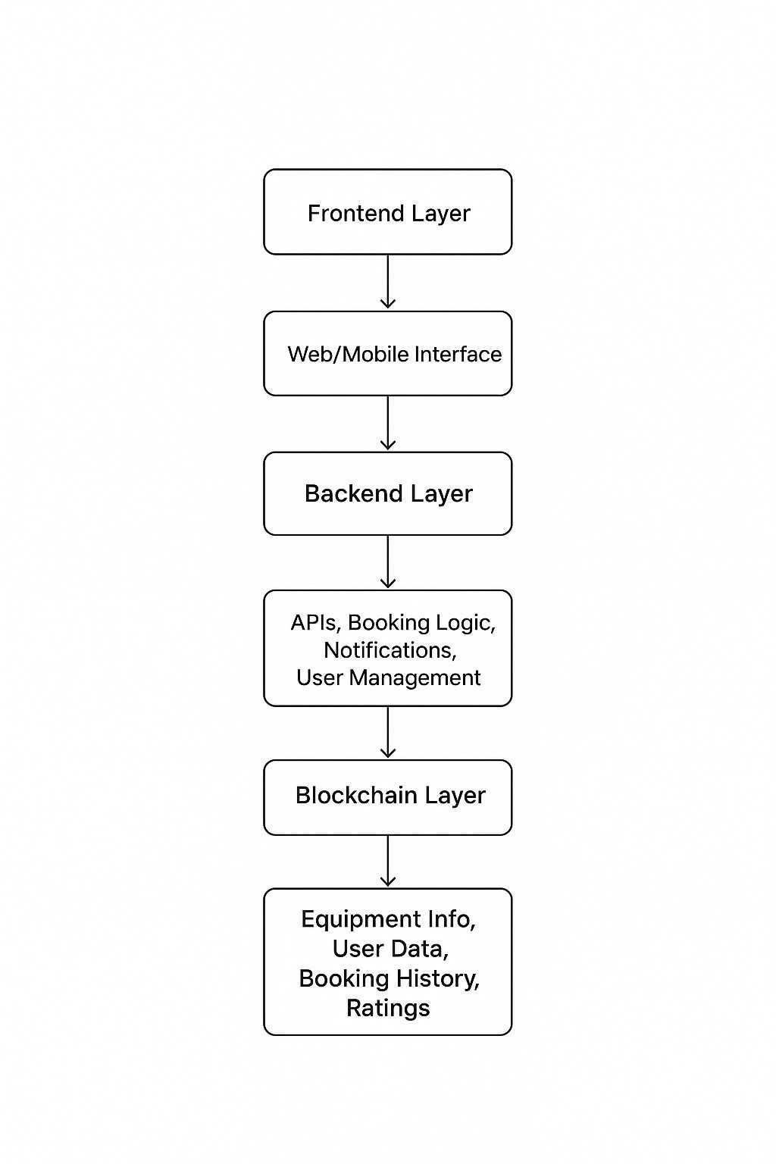
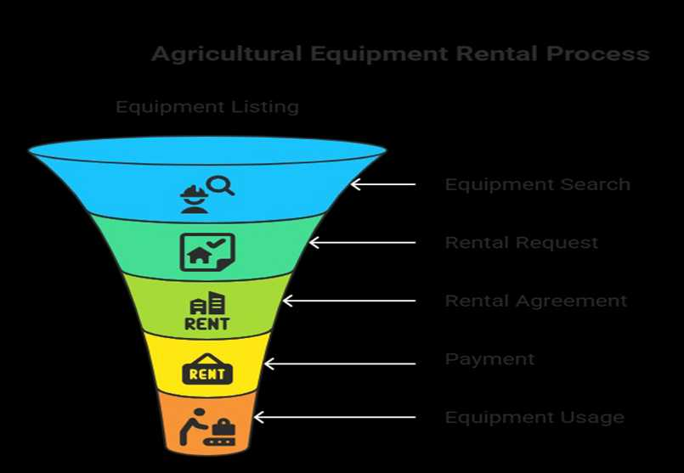

Slide 12
Architecture Diagram

Slide 13
Technologies & Methodologies
Frontend Layer
●
●
●
Tech: HTML/ CSS/ JS
Purpose: User-friendly interface for farmers, owners, admins. Customization: Real-time dashboards, notifications for booking & payment.
Backend Layer
●
●
●
Tech: Node.js, MongoDB
Purpose: Handles APIs, bookings, user management. Customization: Optimized search & booking, modular rental services.
Blockchain Layer
●
●
●
Tech: Ethereum
Purpose: Secure, immutable transactions via smart contracts. Customization: Automated rental agreements, conditional payment release, rating system.

Slide 14
Data Storage Layer
●
●
Purpose: Stores equipment, users, bookings, feedback. Customization: Indexed tables for fast search, blockchain sync logs.
Proposed Changes
●
●
Automated notifications & dispute handling.
Modular architecture for future features like dynamic pricing

Slide 15
Implementation

Slide 16
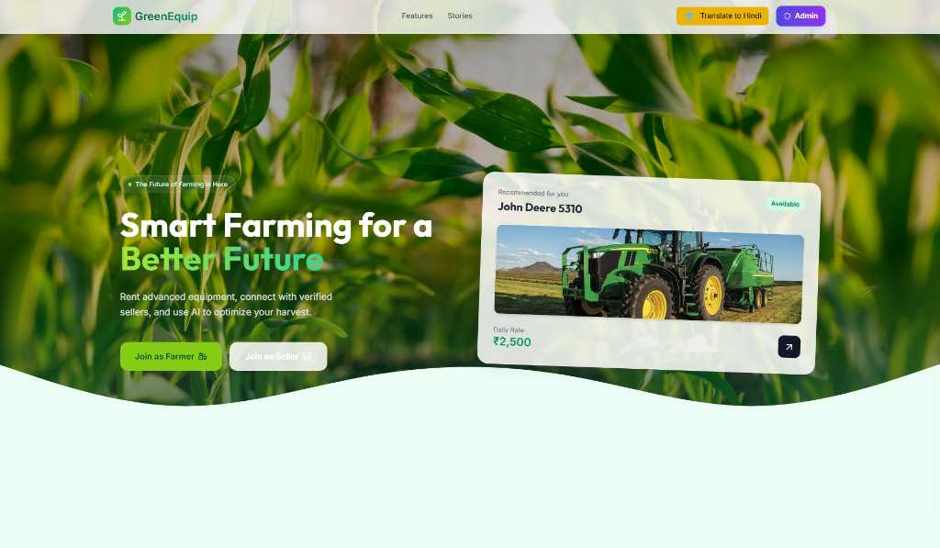

Slide 17
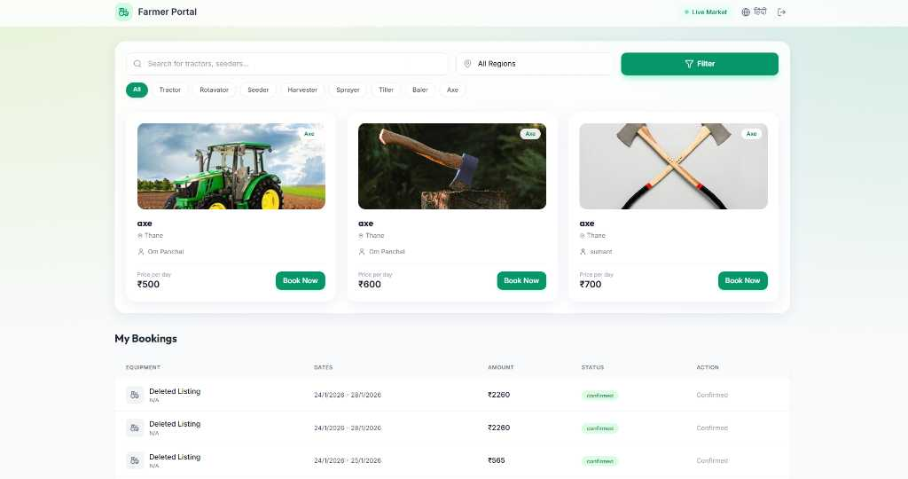

Slide 18
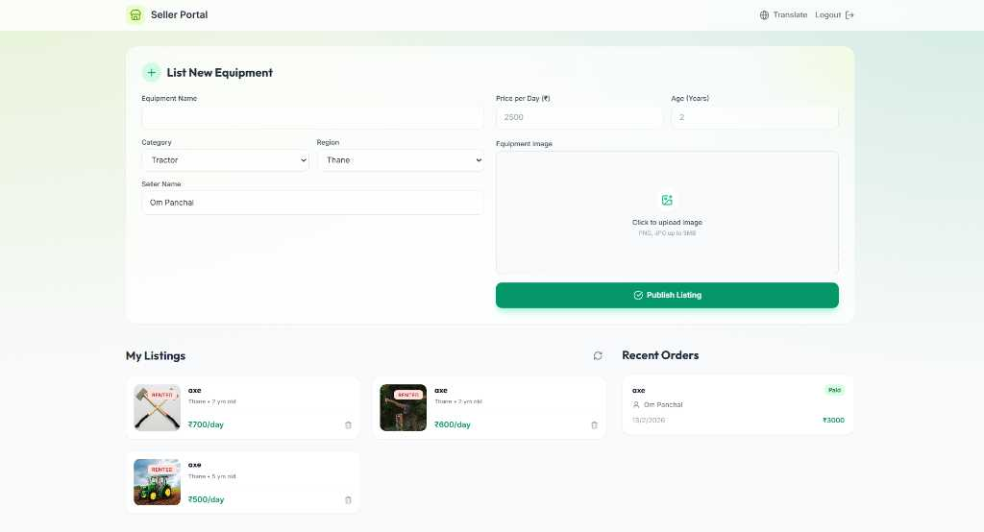

Slide 19
Result
●
Successfully developed a functional decentralized web application for agricultural equipment rental using Ethereum smart contracts.
●
Achieved secure, tamper-proof, and transparent rental transactions eliminating the need for third-party mediation.
●
Enabled seamless booking, payment, and feedback mechanisms with a user-friendly interface.
●
Demonstrated trustless automation of rental agreements and conditional payment release through blockchain.
●
Laid the groundwork for future enhancements like IoT integration, predictive maintenance, and AI-based rental demand forecasting.

Slide 20
Conclusion
In conclusion, the GreenEquip project successfully demonstrates the development of a functional, decentralized application for a peer-to-peer agricultural equipment rental marketplace.
By integrating a user-friendly frontend with a robust Ethereum smart contract, the platform delivers core features including equipment registration, secure weekly rentals, and dynamic searching and filtering.
The project's key innovation is its use of blockchain to remove the need for a central intermediary, creating a transparent, efficient, and trustless ecosystem.

Slide 21
References
Sr. No | Reference | Link
[1] | Smart Farming: Securing Farmers Using Block Chain Technology and IOT P. Praveen, Mohammed Ali Shaik, T. Sampath Kumar, and Tanupriya Choudhury, (2021) | https://www.researchgate.net/publication/352377264_Smart_Farming_Securing_Farmers_Using_Block_Chain_Technology_and_IOT
[2] | Ethical Marketing in the Blockchain- Based Sharing Economy: Theoretical Integration and Guiding Insights Published: 16 December 2021 Volume 183, pages 1113–1140, (2023) | Ethical Marketing in the Blockchain-Bas ed Sharing Economy: Theoretical Integr ation and Guiding Insights | Journal of B usiness Ethics
[3] | Block chain based agricultural supply chain-A review Harshitha M S, Shashidhar R (2021) | Block chain based agricultural supply ch ain-A review - ScienceDirect

Slide 22
Thank You...!!

